Slide 1

ENGINEERING CHEMISTRY
Asha A
Department of Science and Humanities

Slide 2

ENGINEERING CHEMISTRY
Module 7- Functional materials-Polymers
Class content:
Commercial Polymers
Butyl Rubber
Biodegradable polymers
Epoxy Resin

Slide 3
ENGINEERING CHEMISTRY
Module 7- Functional materials-Polymers
Elastomers
The property of a polymer by which it deforms on applying force and regains original shape on release of force is called elasticity
Elastomers have long, coiled and entangled chains which straighten and orient themselves on stretching ; when stress is removed they go back to coiled form

Slide 4
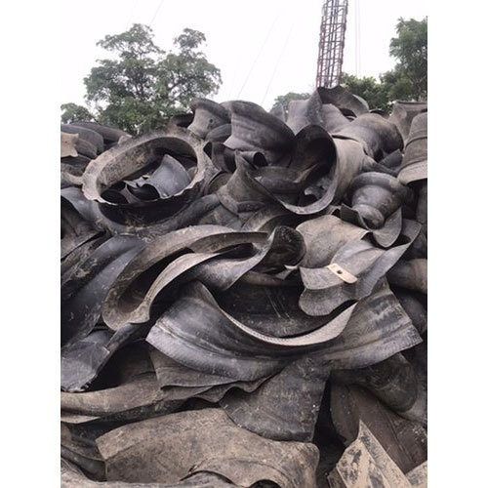
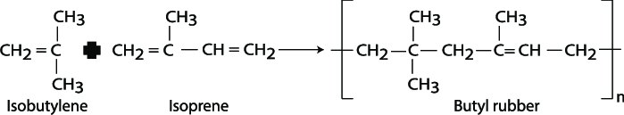
ENGINEERING CHEMISTRY
Module 7- Functional materials-Polymers
Butyl Rubber
Synthetic rubber with diverse applications
Superior to natural rubber in certain properties
Synthesis :
Low temperature copolymerisation of isobutylene and small amount of isoprene(5-10%) dissolved in CH₃Cl
Monomers: Isobutylene and 5-10 % isoprene
-95ºC
AlCl₃
CH₃Cl
Source:https://www.researchgate.net/figure/The-process-of-butyl-rubber-polymerization_fig2_330899891

Slide 5
ENGINEERING CHEMISTRY
Module 7- Functional materials-Polymers
Process:
Isobutylene mixed with isoprene is dissolved in CH₃Cl
Anhydrous AlCl₃ dissolved in CH₃Cl is added and the reaction is carried out at a
low temperature of -95ºC
A finely powdered butyl rubber is obtained
Isoprene introduces unsaturation in the polymer chain and helps in
vulcanisation
The product is mixed with antioxidants and dried to prevent degradation

Slide 6
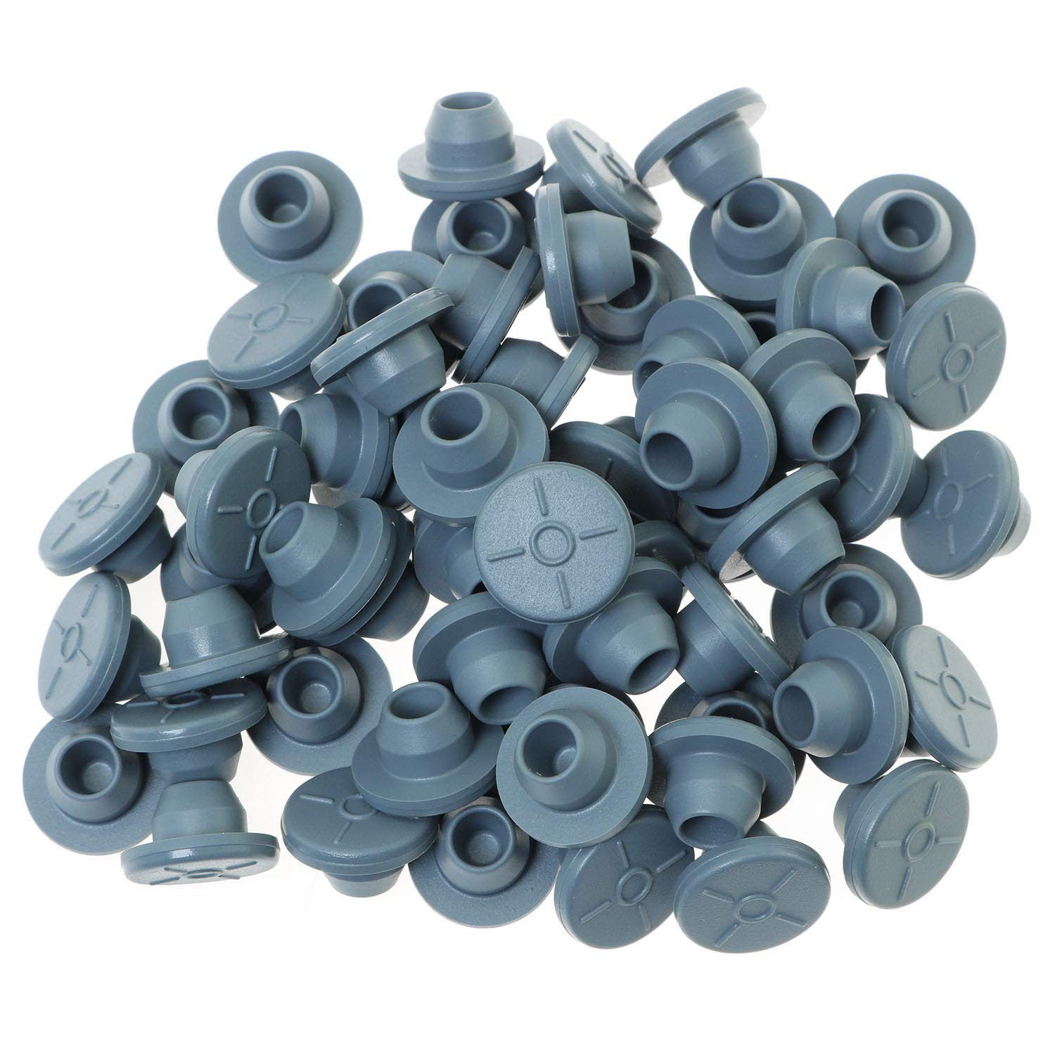
ENGINEERING CHEMISTRY
Module 7- Functional materials-Polymers
Properties:
Exceptional resistance to gas and moisture
(water and steam) permeation
Good chemical inertness
Excellent electrical insulation

Slide 7
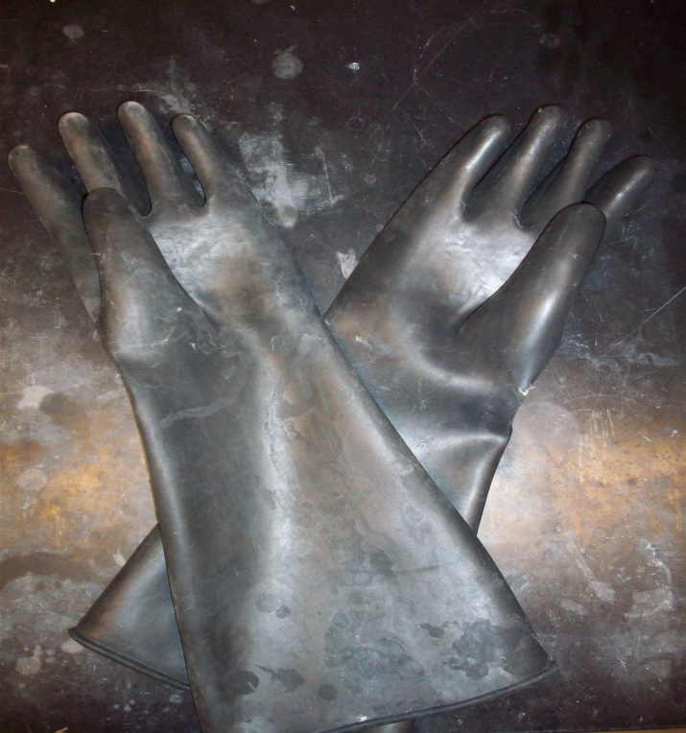
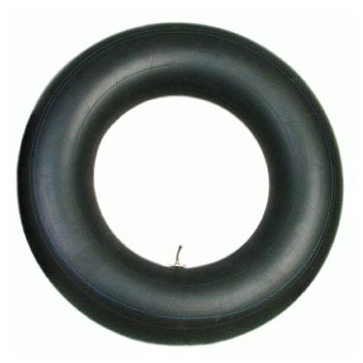
ENGINEERING CHEMISTRY
Module 7- Functional materials-Polymers
Applications:
Excellent impermeability to gas makes it very useful in seals for vacuum applications
Gas impermeability coupled with its air retention capabilities makes it popular for use in tyre inner liners and inner tubes
Insulation of high voltage wires and cables
Hydraulic applications where synthetic fluids are used

Slide 8
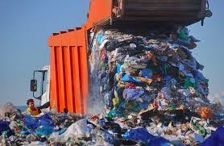
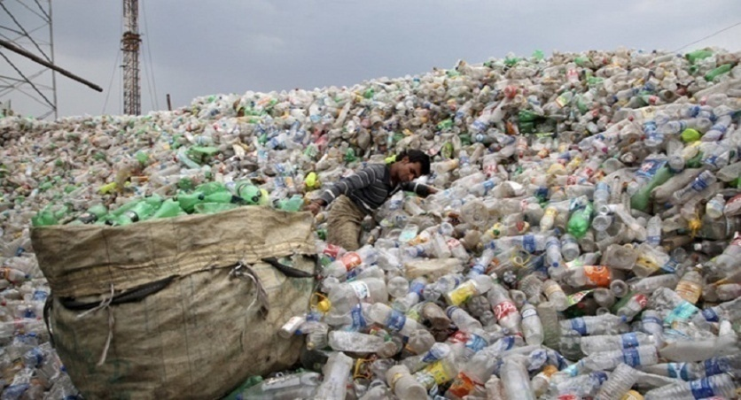
ENGINEERING CHEMISTRY
Module 7- Functional materials-Polymers
Biodegradable Polymers
Every year we produce millions of tons of garbage which we dispose off in landfills
Waste disposal problems of these traditional plastics which are resistant to microbial degradation causes them to accumulate in the environment which is a serious threat to global ecology
Source:https://steemit.com/oceans/@alchemylgc/every-minute-one-garbage-truck-of-plastic-is-dumped-into-our-oceans-this-has-to-stop
Source:http://www.businessworld.in/article/-79-Of-Total-Plastic-Waste-Stored-In-Landfills-Or-Aquatic-Bodies-/26-07-2017-122920/

Slide 9
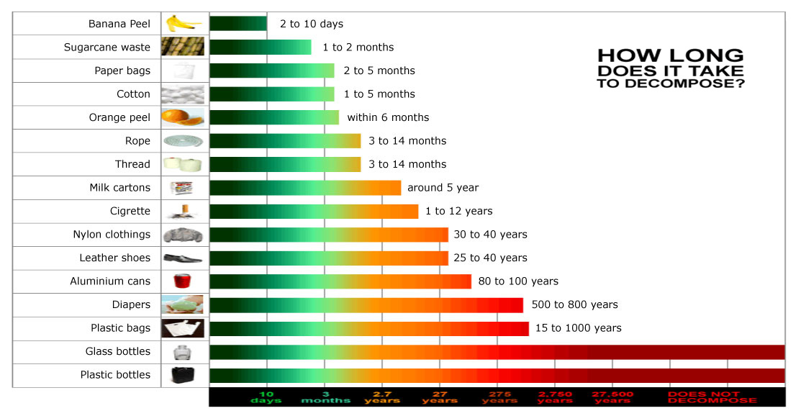
ENGINEERING CHEMISTRY
Module 7- Functional materials-Polymers
Source:https://ahlaprsacks.com/faq/

Slide 10
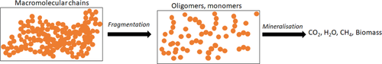
ENGINEERING CHEMISTRY
Module 7- Functional materials-Polymers
Biodegradable polymers: Polymers that can be decomposed by the action of microorganisms into water, carbon dioxide, methane and biomass
Biodegradation is a two step process:
The first step is fragmentation where the polymer macromolecule is broken down into smaller chains or monomers by hydrolysis or oxidation
The second step is mineralisation by microorganisms .The products are CO₂, CH₄, H₂O or biomass depending on the structure of the fragmented polymer chains and the environment they are exposed to
Source:https://onlinelibrary.wiley.com/doi/full/10.1002/macp.202000017

Slide 11
ENGINEERING CHEMISTRY
Module 7- Functional materials-Polymers
The susceptibility of a polymer to undergo degradation depends on :
The structure of the polymer, molecular weight, degree of branching, crystallinity and solubility
Usually polyesters, polyamides, polyurethanes are found to be biodegradable
The environmental conditions like pH, availability of O₂, light, temperature, humidity, microorganism etc.

Slide 12
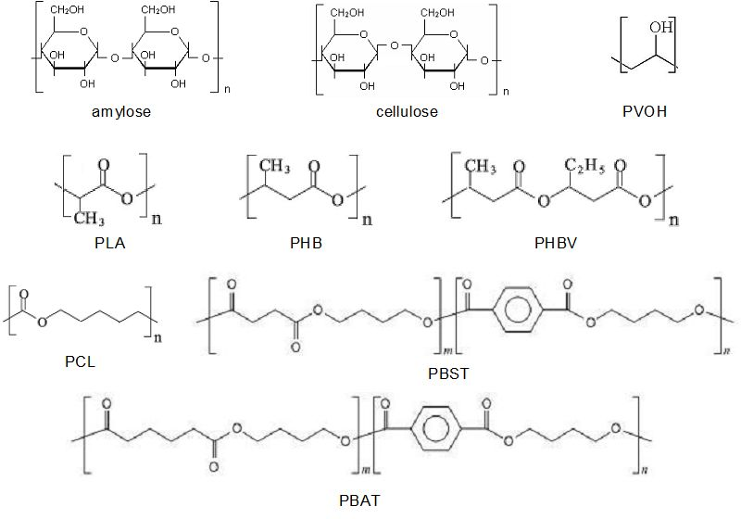
ENGINEERING CHEMISTRY
Module 7- Functional materials-Polymers
Examples of Biodegradable polymers
Abbreviation | Name of the polymer
PVOH | Polyvinyl Alcohol
PLA | Polylacetic acid
PHB | Polyhydroxybutyrate
PHBV | Poly(hydroxybutyrate-co-hydroxyvalerate)
PCL | Polycaprolactone
PBST | Poly(butylenesuccinate-co-terepthallate)
PBAT | Poly(butyleneadipate-co-terepthallate)
Source:https://www.intechopen.com/books/polymer-science/polymers-and-the-environment

Slide 13
ENGINEERING CHEMISTRY
Module 7- Functional materials-Polymers
Biodegradable polymers
Natural
Synthetic
Collagen
Cellulose
Starch
Chitosan
Fibrin
Polyesters
Polyanhydrides
Polyphosphazenes
Polyphosphoesters

Slide 14
ENGINEERING CHEMISTRY
Module 7- Functional materials-Polymers
Biodegradable plastics are commonly produced from renewable raw materials, micro-organisms, non- renewable raw materials like petrochemicals
Natural biodegradable polymers are derived from renewable resources , e.g., starch, cellulose, proteins
Synthetic biodegradable polymers are obtained from :
renewable resources e.g., Polylactic acid(PLA)
non – renewable resources like petroleum e.g., Polyglycolic acid (PGA), Polybutylene succinate (PBS), Polybutylene adipate terephthalate (PBAT)
Microbial polymers e.g.,Poly β-hydroxyalcanoates(PHA)

Slide 15
ENGINEERING CHEMISTRY
Module 7- Functional materials-Polymers
Advantages of biodegradable polymers:
Reduced emission of greenhouse gases and bring a general reduction in plastic waste and waste management
Can be broken down by naturally occurring microorganisms
Easy to use and recycle
Consume less energy during manufacture than the conventional plastic material
Do not release harmful products into the environment on decomposition
They decompose more quickly as compared to non-biodegradable polymers

Slide 16

ENGINEERING CHEMISTRY
Module 7- Functional materials-Polymers
APPLICATIONS:
Organic waste collection and diversion
Agricultural and horticultural sectors (for example, as mulch-films or plant pots)
Food packaging
Disposable tableware
In medicine for drug delivery and dissolvable sutures

Slide 17
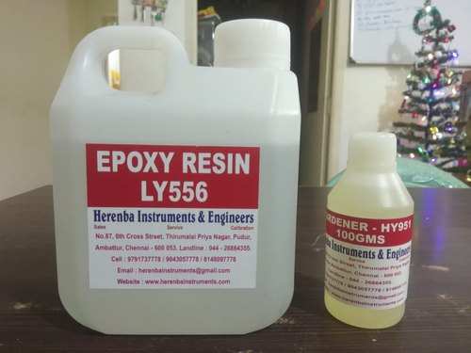
ENGINEERING CHEMISTRY
Module 7- Functional materials-Polymers
Class content:
Adhesives
Epoxy resin

Slide 18
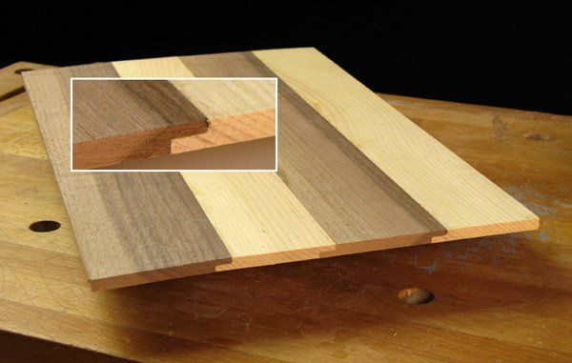
ENGINEERING CHEMISTRY
Module 7- Functional materials-Polymers
Adhesives
Substances used to bind two or more materials firmly by surface attachment due to penetration of adhesive into material and solidification leading to interfacial locking
Natural adhesives- gum, glue, starch
Synthetic adhesives - PF, UF, epoxides
Adhesives are low molecular weight polymers which are dissolved in solvent. A curing agent is added which causes cross-linking to happen and a thermosetting solid polymer is formed
Preferred for bonding of selected group of materials
PF - rubber
UF-Wood
Epoxy resin – metal, wood, glass, concrete, leather

Slide 19
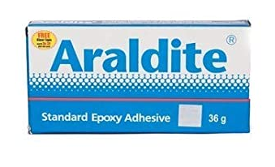
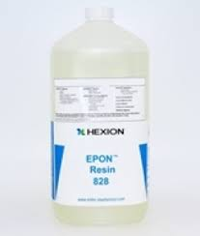
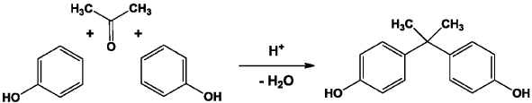
ENGINEERING CHEMISTRY
Module 7- Functional materials-Polymers
Epoxy resins:
They contain the epoxy group, which is a 3 membered ring of an O atom bonded to carbon atoms
Commercially epoxy resins are known as Araldite or Epon
Synthesis : Epoxy resins can be obtained by the condensation reaction between bisphenol A and epichlorohydrin
Bisphenol A
Source:https://www.oatext.com/bisphenol-a-in-odontology-recent-data.php#gsc.tab=0

Slide 20
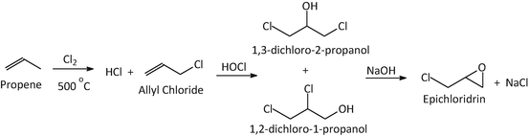
ENGINEERING CHEMISTRY
Module 7- Functional materials-Polymers
Epichlorohydrin
Source:https://link.springer.com/chapter/10.1007/978-3-319-59375-3_4

Slide 21
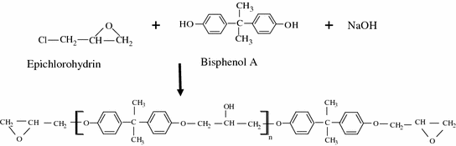
ENGINEERING CHEMISTRY
Module 7- Functional materials-Polymers
Synthesis of epoxy resin:
Source:https://link.springer.com/chapter/10.1007/978-3-662-54959-9_7
Excess of epichlorohydrin is used so that the end groups are epoxy groups which are very active
When curing agents are added immediately three – dimensional crosslinked structure is formed
Curing agents are diamines, dicarboxylic acids or acid anhydrides

Slide 22
ENGINEERING CHEMISTRY
Module 7- Functional materials-Polymers
Properties :
Excellent adhesion
Excellent resistance to water, acid, alkali and other
corrosive chemicals
High mechanical strength
Absorb less moisture
Good insulation properties

Slide 23
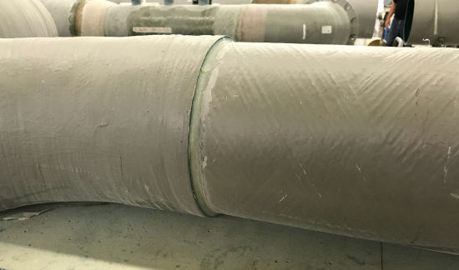
ENGINEERING CHEMISTRY
Module 7- Functional materials-Polymers
Applications:
Cured epoxies are frequently used in aerospace and defence
They can used to bind glass, metal, leather, wood, ceramic etc
Coated on floor to give it an antiskid layer
Laminating materials
Crease and shrinkage resistance fabrics

Slide 24
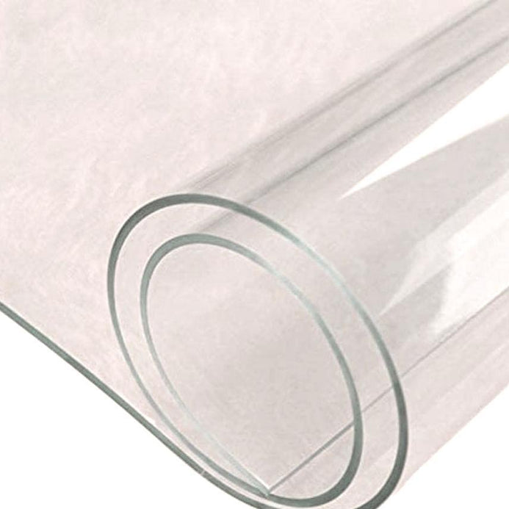
ENGINEERING CHEMISTRY
Module 7- Functional materials-Polymers
Class content: Polymers - PMMA
Poly (Methyl Methacrylate)-PMMA
Synthesis
Properties
Applications
Advantages
24

Slide 25
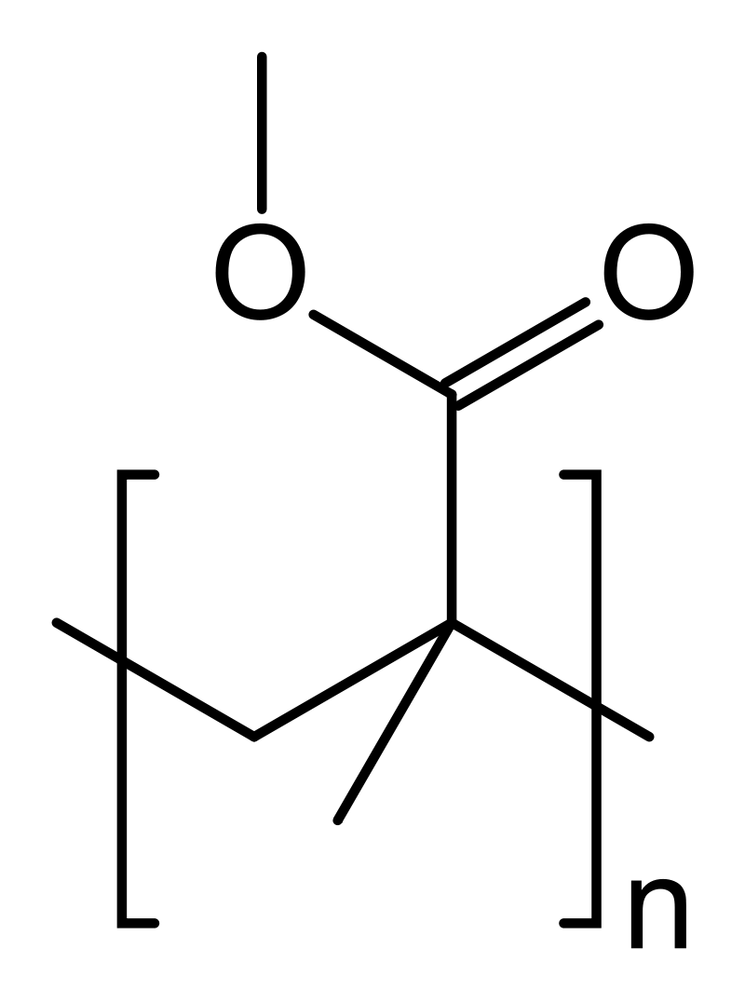
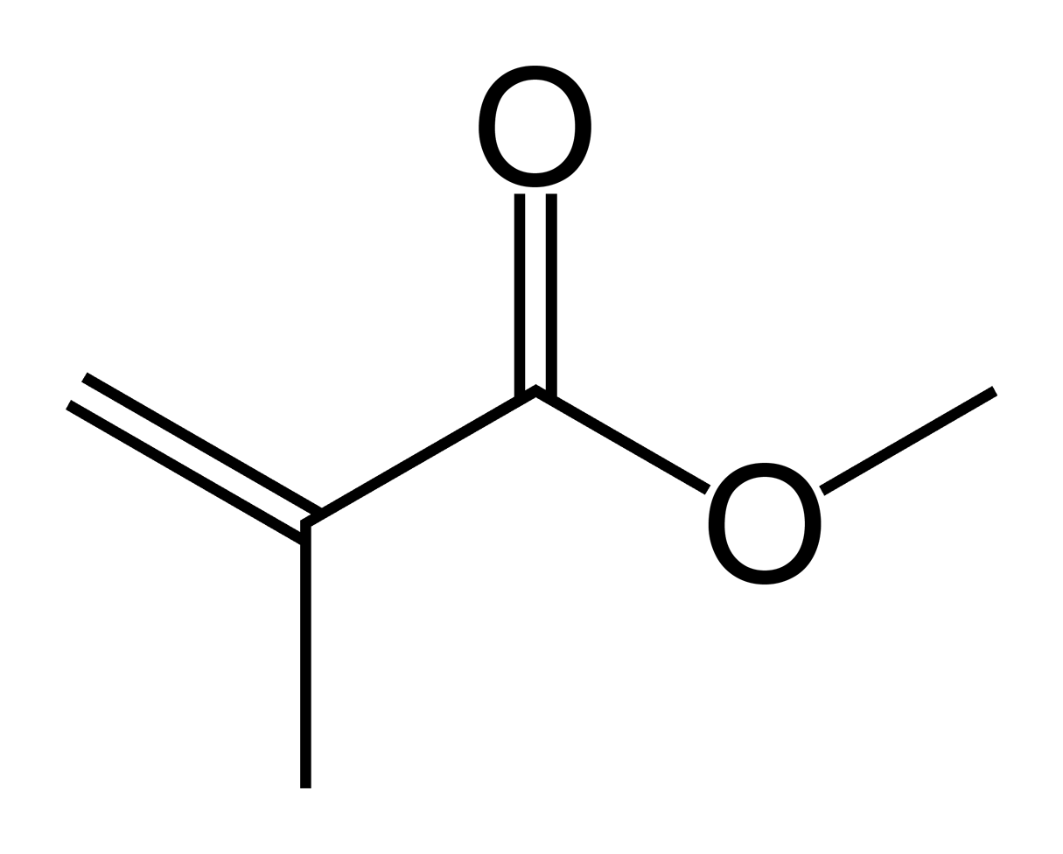
ENGINEERING CHEMISTRY
Module 7- Functional materials-Polymers
PMMA :
PMMA formed by free radical polymerization of monomer methyl methacrylate (MMA).
Polymethyl methacrylate structure- vinyl polymer an ester of methacrylic acid (CH₂=C[CH₃]CO₂H)
PMMA an commercial success polymer known as acrylic, acrylic glass by trade names crylux, Plexiglas, acrylate
MMA PMMA
25

Slide 26
ENGINEERING CHEMISTRY
Module 7- Functional materials-Polymers
PMMA Synthesis :
Monomer synthesis from acetone to MMA
MMA polymerization to PMMA
26

Slide 27
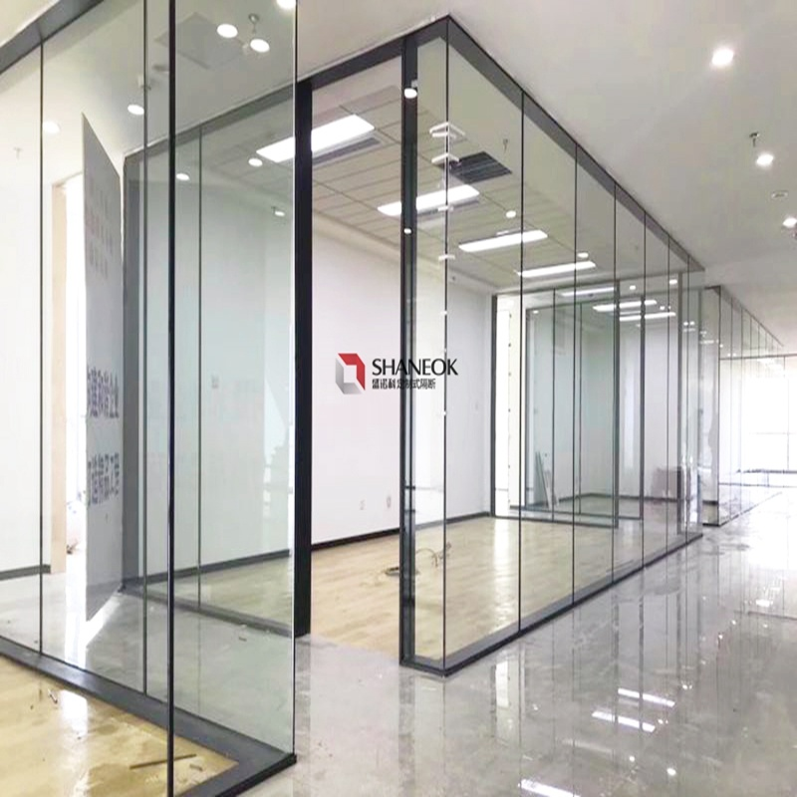
ENGINEERING CHEMISTRY
Module 7- Functional materials-Polymers
PMMA Properties :
PMMA is amorphous, white highly transparent, thermoplastic material (moldable at 60-80ºC )
Dissolves in organic solvents
Has poor scratch resistance
Inert to acid environmental deterioration
27

Slide 28
ENGINEERING CHEMISTRY
Module 7- Functional materials-Polymers
PMMA Applications:
Acrylic plastic or PMMA finds its application in a variety of industries due to its properties
Easy processing and cost-effectiveness
PMMA is processed by injection, compression moulding, extrusion or casting
The extensive polymethyl methacrylate uses are a result of its advantageous properties and adaptability
28

Slide 29
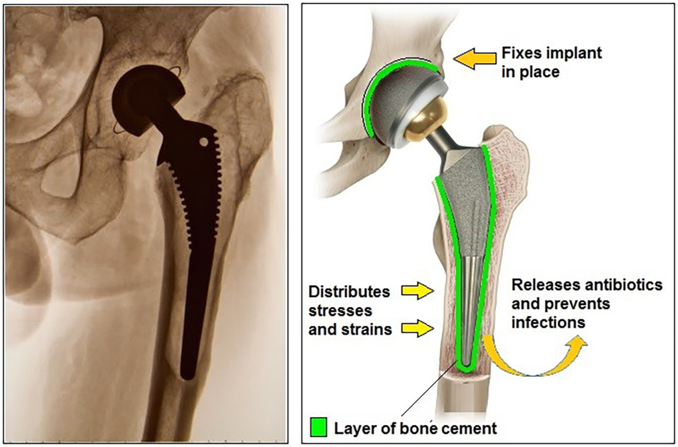
ENGINEERING CHEMISTRY
Module 7- Functional materials-Polymers
PMMA Applications:
Glass Substitute: Used in aquariums, aircraft canopies and sign boards, display systems
Construction and Design: Windows, doors, panels, canopies etc., due to its excellent properties such as heat insulation and light transmission.
Automobile Industry: Car windows to windshields, car indicator covers, and panels are also made using plexiglass
Healthcare Industry: known as bone cement- Used by orthopaedic surgeons for joint replacement or treating bone damages. Optical fibres used for endoscopy also consist of PMMA.
29

Slide 30
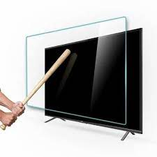
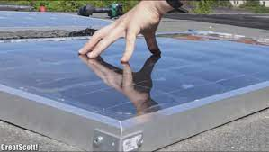
ENGINEERING CHEMISTRY
Module 7- Functional materials-Polymers
PMMA Applications :
Cosmetic Usage: PMMA used in various beauty products and injectables. It is used in cosmetic procedures that treat acne, facial lines, wrinkles etc.
Lamps and Lighting: Used in LED lights and lamps- street and traffic lights and lighting devices.
Electronic Devices: Used in the display of various electronic equipment, including tv screens, laptops and smartphones.
Solar Devices: In solar panels is a result of its UV stability and light transmission ability.
Other products where this polymer finds its application include paint, furniture and optical fibres used for telecommunication.
30

Slide 31
ENGINEERING CHEMISTRY
Module 7- Functional materials-Polymers
Advantages of PMMA
PMMA has several advantages over other polymers like polycarbonate (PC) and polystyrene etc. It doesn’t scratch easily or yellow over time. Used as an alternative to other transparent polymers
Some of the advantages of PMMA include:
Economical, Resistance to weathering
Various colouring options, High Tensile strength
Easy to process and handle, Versatility, Biocompatibility
UV-Stability, Durability, Transmittance and better optical clarity
Recyclable, Polishability and Non-toxic
31

Slide 32
ENGINEERING CHEMISTRY
Module 7- Functional materials-Polymers
Class content:
Polymer Composites
Kevlar
Synthesis
Properties
Applications
Reinforced Kevlar composites

Slide 33
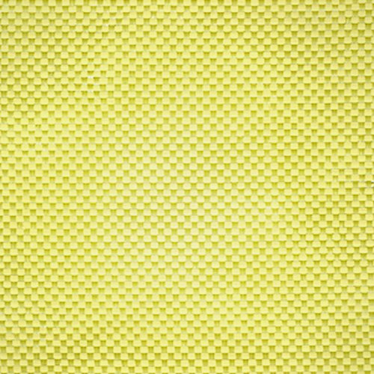
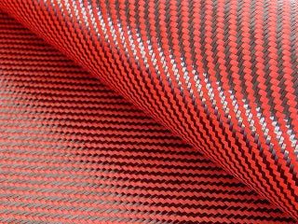
ENGINEERING CHEMISTRY
Module 7- Functional materials-Polymers
Polymer composites
Materials made from two or more constituent materials and their properties are not attainable by any individual component alone are called composites
When one or more of the components are polymers they are called polymer composites
Two components are fibre and matrix
matrix: polyester, epoxy, phenolic, silicone, melamine, vinyl derivatives
fibers: glass fiber, boron filaments, carbon/graphite fibers, aramid (aromatic polyamide), aluminum fiber
Polymer composite are produced by suitably bonding a fiber material with a polymer resin matrix and curing the same under pressure and heat
Composites have high strength / unit weight

Slide 34
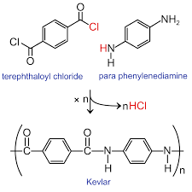
ENGINEERING CHEMISTRY
Module 7- Functional materials-Polymers
Kevlar
An aramid fibre - Aromatic polyamide
Chemical name is poly-paraphenyleneterepthalamide
Synthesis :
Condensation of 1,4 phenylene diamine and 1,4-benzenedicarbonyl chloride
Source:https://mccord.cm.utexas.edu/chembook/page-nonav.php?chnum=8&sect=6

Slide 35
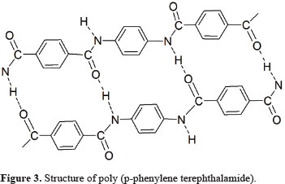
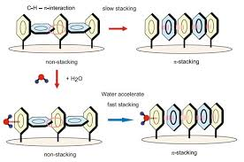
ENGINEERING CHEMISTRY
Module 7- Functional materials-Polymers
Kevlar is very strong material – about 5 times stronger than steel
High strength is due to:
Many inter chain hydrogen bonds. The inter-molecular hydrogen bonds formed between the carbonyl groups and NH centers
Additional strength is derived from aromatic stacking interactions between adjacent strands
Source:https://www.scielo.br/scielo.php?script=sci_arttext&pid=S1516-14392014000500012
Source:https://www.nanowerk.com/nanotechnology-news2/newsid=52521.php

Slide 36
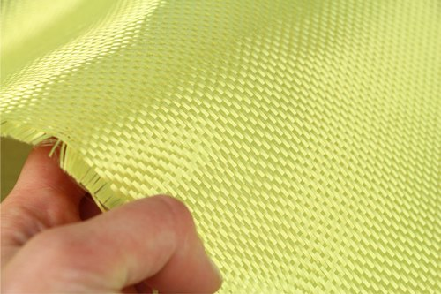
ENGINEERING CHEMISTRY
Module 7- Functional materials-Polymers
Properties :
High tensile strength, high modulus of elasticity
High strength to weight ratio
High chemical inertness
Low co-efficient of thermal expansion
Flame resistance
High impact and cut resistance
Textile processibility

Slide 37
ENGINEERING CHEMISTRY
Module 7- Functional materials-Polymers
Applications :
Well known component of personal armor such as combat helmets,
ballistic face mask and ballistic vest, bullet proof vest
Gloves, sleeves, jackets and other articles
Inner lining in bicycle tires
Light weight boat hulls, aircraft panels, race cars, bridge structure,
Roto blades, tennis, cricket bats, and hockey sticks
Fiber is used in woven rope and in cable
As reinforcement in car tires, in car brakes
In the strings of archery bows
Disadvantages:
Special cutting scissors and drilling machines are required
The fibre is hygroscopic- they absorb moisture

Slide 38
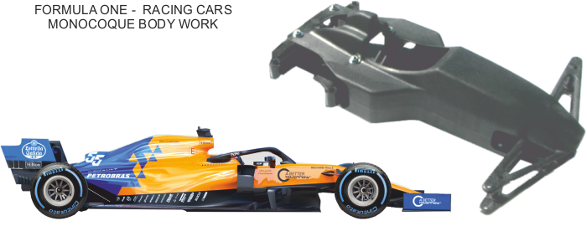

ENGINEERING CHEMISTRY
Module 7- Functional materials-Polymers
Reinforced Kevlar composites
Kevlar composite is made by combining Kevlar fibre with epoxy resin
Applications :
monocoque bodies of F1 racing cars, helicopter rotor blades, kayaks, tennis and squash rackets

Slide 39
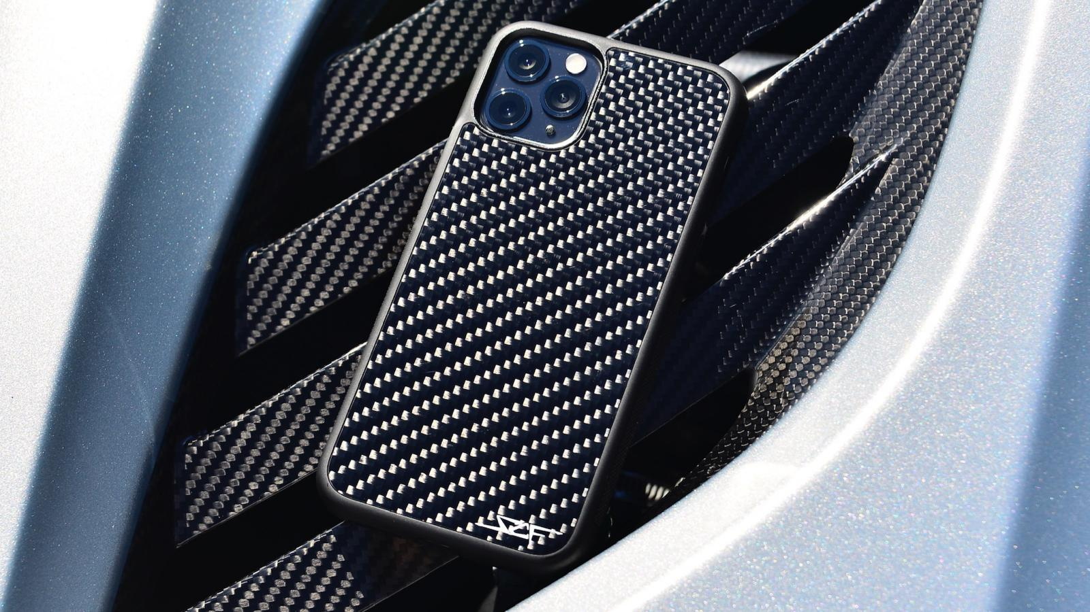
ENGINEERING CHEMISTRY
Module 7- Functional materials-Polymers
Class content:
Polymer Composites
Carbon fibre
Synthesis
Properties
Applications
Carbon Fibre Reinforced Polymer(CFRP)

Slide 40
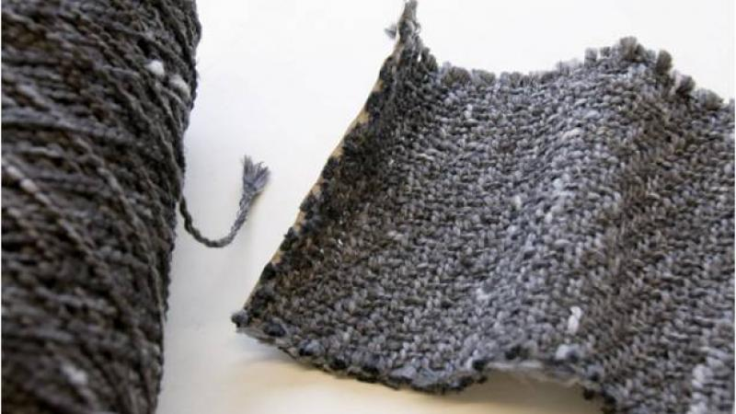
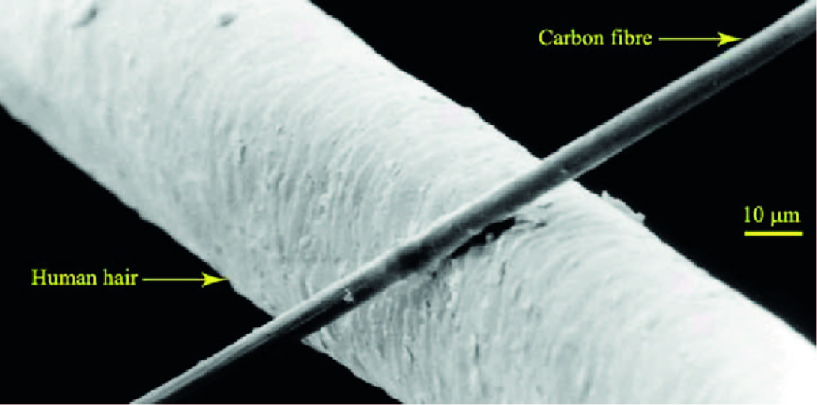
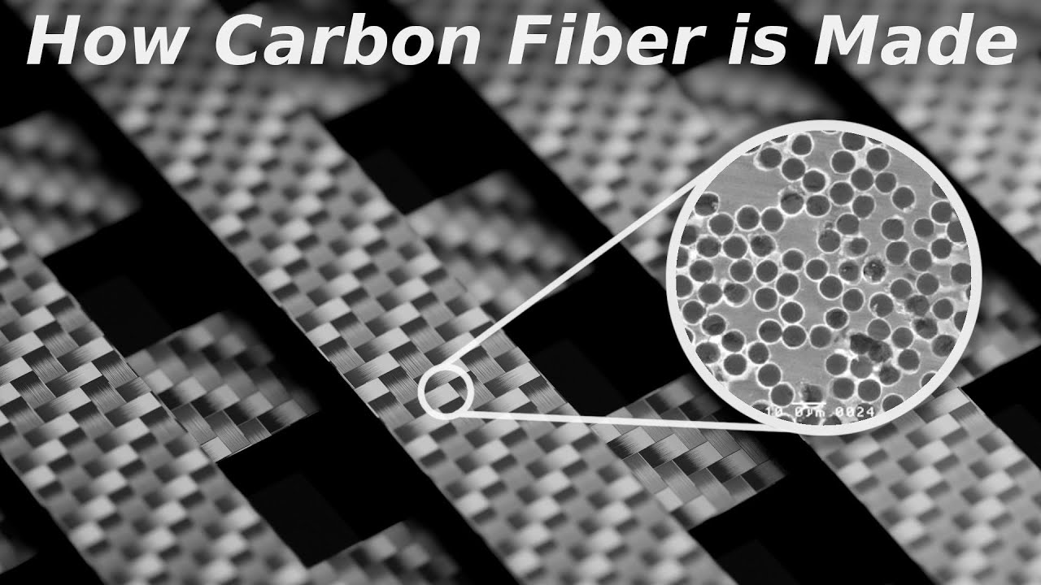
ENGINEERING CHEMISTRY
Module 7- Functional materials-Polymers
Carbon fibres
Fibers about 5–10 micrometers in diameter and composed mostly of carbon atoms
Several thousand Carbon fibres are twisted together to form a yarn which is used as such or woven into fabric
Source:https://www.racecar-engineering.com/tech-explained/how-are-composites-used-in-motorsport/attachment/composites-in-motorsport-carbon-fibre-vs-human-hair/

Slide 41
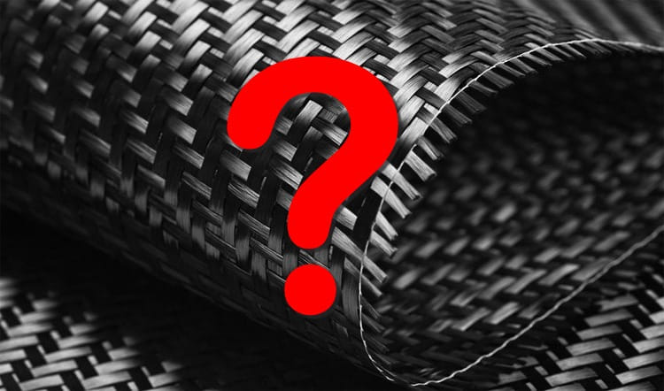
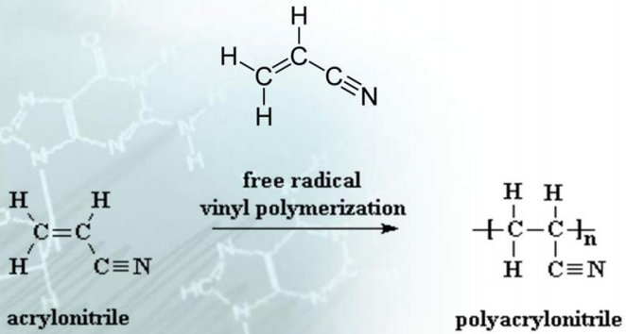
ENGINEERING CHEMISTRY
Module 7- Functional materials-Polymers
Synthesis:
Each Carbon filament is produced from a precursor polymer like polyacrylonitrile(PAN), pitch etc.
Synthesis of C fibre from polyacrylonitrile (PAN)
polyacrylonitrile (PAN) is obtained from polymerisation of acrylonitrile
Source:https://slideplayer.com/slide/8375801/

Slide 42

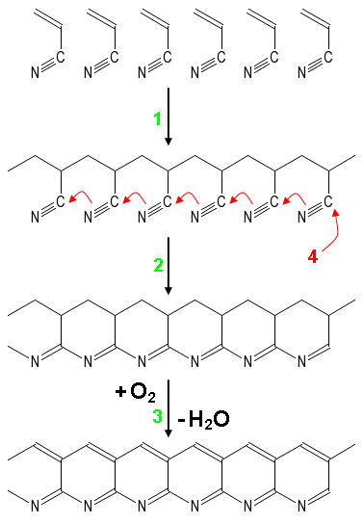
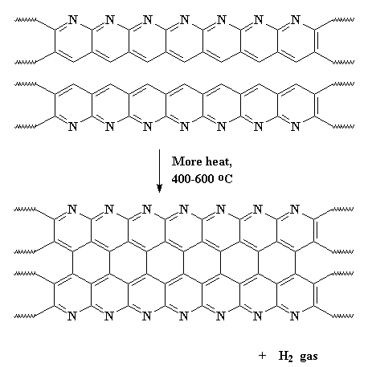

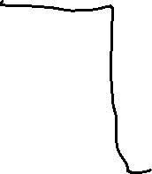

ENGINEERING CHEMISTRY
Module 7- Functional materials-Polymers
Steps involved in the synthesis of Carbon fibre
Polymerisation
Cyclisation at low temperature
Oxidative treatment at high temperature
Graphitisation at 2000ºC in an inert atmosphere

Slide 43
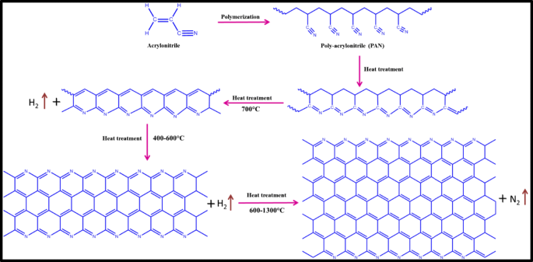

Slide 44
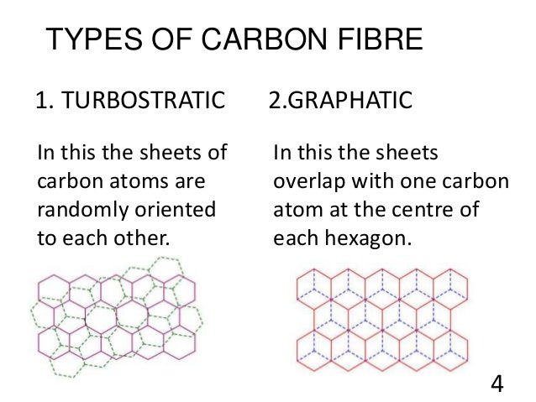
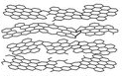
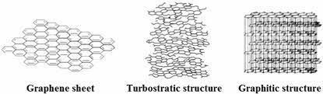
ENGINEERING CHEMISTRY
Module 7- Functional materials-Polymers
Structure:
Consists of sheets of carbon arranged in a regular pattern like graphite
but the sheets interlock
In turbostratic carbon fibre the sheets of carbon fibre are haphazardly
folded or crumpled together
Source:https://www.researchgate.net/figure/Schematic-representation-of-chemical-structure-of-lignin-cellulose-PAN-and-mesophase_fig4_302483625

Slide 45
ENGINEERING CHEMISTRY
Module 7- Functional materials-Polymers
Properties :
High strength to weight ratio
Corrosion resistant and chemically stable
Good Tensile Strength
Non Poisonous, Biologically Inert
Low Coefficient of Thermal Expansion

Slide 46
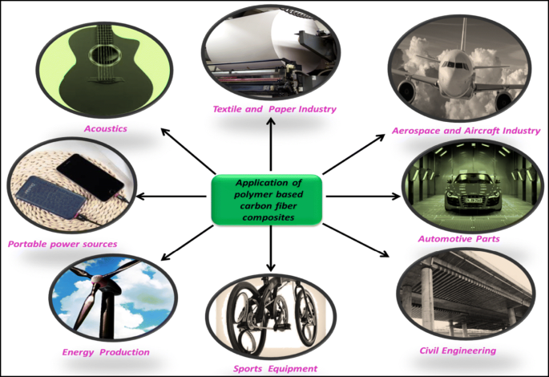
ENGINEERING CHEMISTRY
Module 7- Functional materials-Polymers
Applications :
Aerospace, road and marine transport, sporting
goods
Medical applications in prostheses, surgery and x-ray equipment, implants, tendon/ligament repair
Automobile hoods, novel tooling, casings and bases for electronic equipments, EMI and RF shielding, brushes
Audio equipment, loudspeakers for Hi-fi equipment, pickup arms, robot arms

Slide 47
ENGINEERING CHEMISTRY
Module 7- Functional materials-Polymers
Disadvantages:
Process of producing Carbon fibre is expensive due to
large energy expenditure
Volatile byproducts are formed which include HCN

Slide 48
ENGINEERING CHEMISTRY
Module 7- Functional materials-Polymers
Carbon fibre reinforced polymer(CFRP)
The composite is made by reinforcing carbon fibre with epoxy resin matrix
Properties:
light weight
high strength to weight ratio
low coefficient of thermal expansion
high electrical conductivity

Slide 49
ENGINEERING CHEMISTRY
Module 7- Functional materials-Polymers
Class content:
Conducting polymers
Introduction
Types of doping
Applications

Slide 50
ENGINEERING CHEMISTRY
Module 7- Functional materials-Polymers
Conducting polymers
Polymers are generally insulators because the organic molecules of which they are composed have no free electrons to carry current
An organic polymer with highly delocalized pi-electron system, having electrical conductance of the order of an electrical conductor is called a conducting polymer
Also known as synthetic metals

Slide 51
ENGINEERING CHEMISTRY
Module 7- Functional materials-Polymers
Development :
1977 - Heeger, Macdiarmid & Shirakawa demonstrated conductivity of polyacetylene can be increased 13 times by doping with electron acceptors and donors
Norman et. al - achieved conductance of polyacetylene equal to copper
Doping with less than 10% of chemical species results in dramatic changes in electrical, electronic, magnetic and optical properties of polymers – hence it is a new class of polymers
2000 - Heeger, Macdiarmid & Shirakawa won the Nobel prize for Chemistry

Slide 52
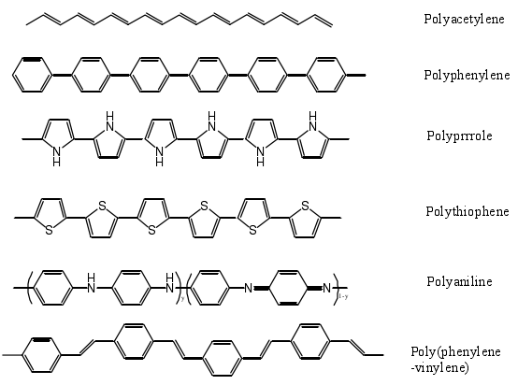
ENGINEERING CHEMISTRY
Module 7- Functional materials-Polymers
Examples of polymers which conduct after doping
Source:https://www.researchgate.net/figure/3Molecular-structure-of-some-typical-conducting-polymers_fig2_304023062

Slide 53
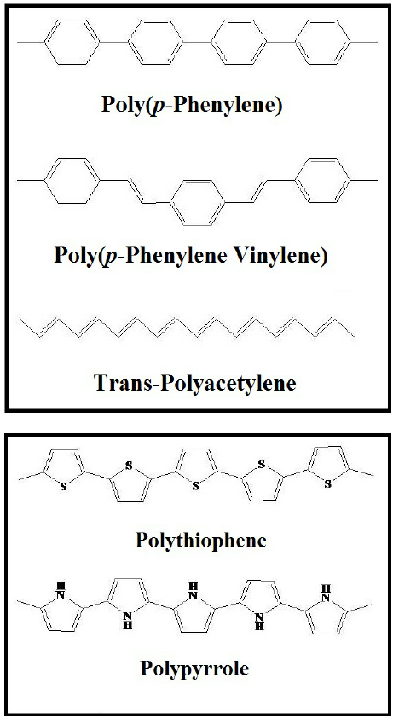
ENGINEERING CHEMISTRY
Module 7- Functional materials-Polymers
Conducting polymers conduct electricity due to delocalization of π electrons
An organic polymer can be converted into conducting polymer if it has :
• linear structure
• extensive conjugation in its polymeric back bone
POLYACETYLENE
POLYPHENYLENE
Source:https://www.researchgate.net/figure/Some-Examples-for-Conducting-Polymers_fig4_269993677

Slide 54
ENGINEERING CHEMISTRY
Module 7- Functional materials-Polymers
These materials in pure form are not conductors but on doping (Introduction of charged chemical species) conduction increases
Types of Doping
Oxidative doping
Reductive doping
Proton doping

Slide 55
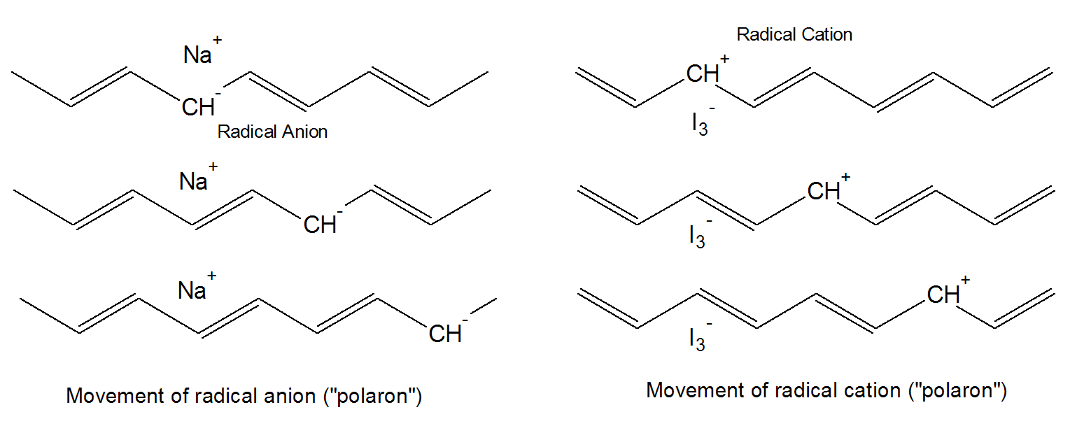
ENGINEERING CHEMISTRY
Module 7- Functional materials-Polymers
Oxidative doping (p-doping)
In this process, pi-backbone of a polymer is partially oxidized using a suitable oxidizing agent
This creates positively charged sites on the polymer backbone which are the current carriers for conduction
The oxidizing agents used are Iodine in CCl₄, HBF₄ etc.
Source:https://polymerdatabase.com/polymer%20physics/Polymer%20Conductivity2.html

Slide 56
ENGINEERING CHEMISTRY
Module 7- Functional materials-Polymers
Reductive doping (n-doping) :
In this process, pi-backbone of a polymer is partially reduced using a suitable reducing agent
This creates negatively charged sites on the polymer backbone which are the current carriers for conduction
The reducing agent used is sodium naphthalide in THF
Source:https://polymerdatabase.com/polymer%20physics/Polymer%20Conductivity2.html

Slide 57
ENGINEERING CHEMISTRY
Module 7- Functional materials-Polymers
Protonic acid doping :
In this technique, current carrying charged species (+ve and –ve) are created by using a protonic acid as dopant
Doping of polyaniline is a typical example of this type of doping
In polyaniline, current carrying charged species (+ve and –ve) are created by protonation of imine nitrogen

Slide 58
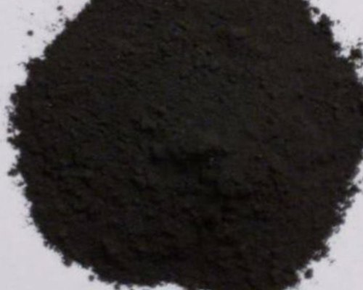


ENGINEERING CHEMISTRY
Module 7- Functional materials-Polymers
Partial oxidation
NH₄S₂O₈
Source:https://www.indiamart.com/proddetail/polyaniline-pani-semi-flexible-rod-polymer-leucoemeraldine-emeraldine-21303398497.html
Protonation
HCl (1M)
Cl⁻
Cl⁻

Slide 59


ENGINEERING CHEMISTRY
Module 7- Functional materials-Polymers
Applications :
As electrode material for commercial rechargeable
batteries, for higher power to weight ratio
As conductive tracks on printed circuit boards
As sensors-humidity sensor, gas sensor, radiation sensor, biosensor
In electrochromic display windows
In information storage devices
As film membranes for gas separations
In light emitting diodes
Important materials in microelectronics applications,
electrocatalysis, fuel cell electrodes, reinforced
composites etc.

Slide 60
THANK YOU
Asha A
Department of Science and Humanities

